Slide 1

Chapter 1
Introduction to Effective Software Testing
Objectives
How the software testing has been evolved?
What are the goals of Software testing?
Model for testing process.
Complete testing is not possible.
Various Schools of Software testing.
© Oxford University Press 2011. All rights reserved.

Slide 2
Evolution of Software Testing
Software Testing 1.0
In this phase, software testing was considered to be just a single phase to be performed after coding of the software in SDLC. No test organization was there. A few testing tools were present but their use was limited due to the high cost. Management was not concerned with the testing as there was no quality goal.
Software Testing 2.0
In this phase, software testing gained the importance in SDLC and the concept of early testing was also started. Testing was evolving into the direction of planning the test resources. Many testing tools were also available in this phase.
© Oxford University Press 2011. All rights reserved.

Slide 3
Evolution of Software Testing
Software Testing 3.0
In this phase, software testing is being evolved in the form of a process which is based on the strategic effort. It means that there should be a process which gives us a road map of the overall testing process. Moreover, it should be driven by the quality goals in mind so that all controlling and monitoring activities can be performed by the managers. Thus, management is actively involved in this phase.
© Oxford University Press 2011. All rights reserved.

Slide 4
Software Testing Myths
Software Testing Myths
Testing is a single phase in SDLC performed after coding.
Testing is easy.
Software development is of more worth as compared to testing.
Complete testing is possible.
The testing starts after the program development.
The purpose of testing is to check the functionality of the software.
Anyone can be a tester.
© Oxford University Press 2011. All rights reserved.

Slide 5
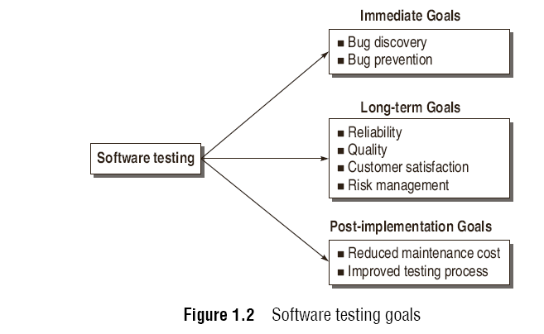
Software Testing Goals
© Oxford University Press 2011. All rights reserved.

Slide 6

Testing produces Reliability and Quality
© Oxford University Press 2011. All rights reserved.

Slide 7
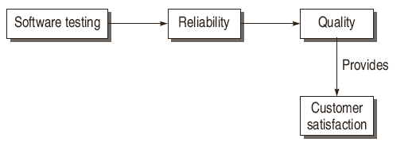
Quality leads to customer satisfaction
© Oxford University Press 2011. All rights reserved.

Slide 8
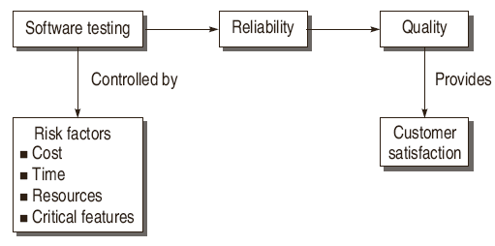
Testing controlled by Risk factors
© Oxford University Press 2011. All rights reserved.

Slide 9
Software Testing Definitions
“Testing is the process of executing a program with the intent of finding errors.”
- Myers [2]
“A successful test is one that uncovers an as-yet-undiscovered error.”
- Myers [2]
“Testing can show the presence of bugs but never their absence.”
- W. Dijkstra [125].
© Oxford University Press 2011. All rights reserved.

Slide 10
Software Testing Definitions
“Testing is a concurrent lifecycle process of engineering, using and maintaining testware (i.e. testing artifacts) in order to measure and improve the quality of the software being Tested.”
- Craig [117]
“Software testing is a process that detects important bugs with the objective of having better quality software.”
© Oxford University Press 2011. All rights reserved.

Slide 11
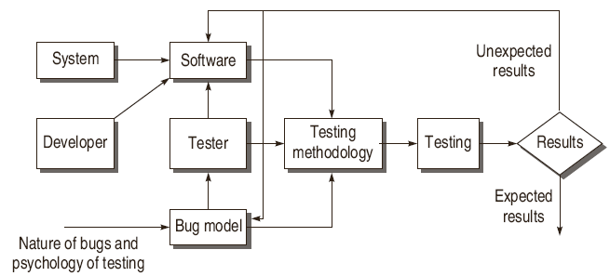
Model for Software Testing
© Oxford University Press 2011. All rights reserved.

Slide 12
Software and software Model
Software complexity
Easy to design
Easy to code
Testable at every point
Avoid unnecessary complexities
© Oxford University Press 2011. All rights reserved.

Slide 13
Bug Model
Perception of the kind of bugs expected
Helps in deciding testing strategy
If we get incorrect result then bug model need to be modified.
© Oxford University Press 2011. All rights reserved.

Slide 14
Testing methodology and testing
Incorporates testing strategy and testing tactics
Roadmap for overall testing process
If we don’t get required result then testing methodology need to be modified
© Oxford University Press 2011. All rights reserved.

Slide 15
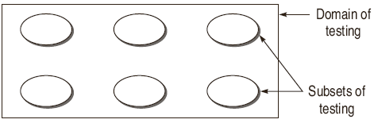
Effective Software Testing vs Exhaustive Software
Testing
© Oxford University Press 2011. All rights reserved.

Slide 16
Effective Software Testing vs Exhaustive Software
Testing
The domain of possible inputs to the software is too large to test.
Valid Inputs
Invalid Inputs
Edited Inputs
Race Conditions
© Oxford University Press 2011. All rights reserved.

Slide 17
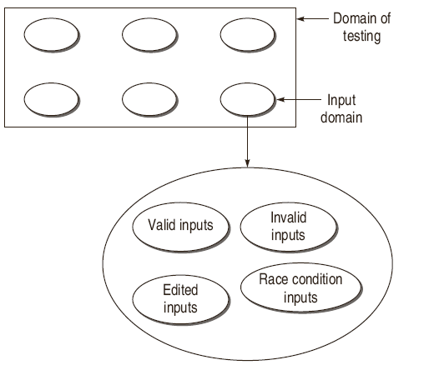
Effective Software Testing vs Exhaustive Software
Testing
© Oxford University Press 2011. All rights reserved.

Slide 18
Valid inputs
Adding of two digit no.s
-99 to 99 i.e (199total)
Total no. of test case combinations =199*199=39601
© Oxford University Press 2011. All rights reserved.

Slide 19
Invalid inputs
Numbers out of range
Combinations of alphabates and digits
Combination of all alphabates
Combination of control characters
Combination of any other key on the keyboard
© Oxford University Press 2011. All rights reserved.

Slide 20
Edited inputs
Adding of spaces when giving the input to the programs
Non functioning of a program
Buffer overflow and system crashes
© Oxford University Press 2011. All rights reserved.

Slide 21
Effective Software Testing vs Exhaustive Software
Testing
There are too many possible paths through the program to test.
1for (int i = 0; i < n; ++i)
2{
3 if (m >=0)
4 x[i] = x[i] + 10;
5 else
6 x[i] = x[i] - 2;
7}...
© Oxford University Press 2011. All rights reserved.

Slide 22
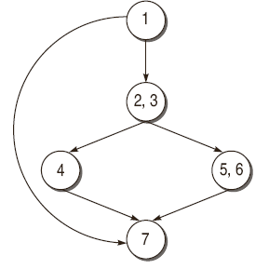
Effective Software Testing vs Exhaustive Software
Testing
if n is 20, then the number of paths will be 2²⁰ + 1, i.e. 1048577.
© Oxford University Press 2011. All rights reserved.

Slide 23
Effective Software Testing vs Exhaustive Software
Testing
Every Design error cannot be found.
© Oxford University Press 2011. All rights reserved.

Slide 24
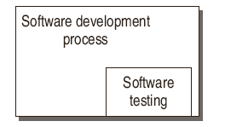
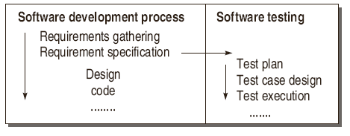
Software Testing as a Process
© Oxford University Press 2011. All rights reserved.

Slide 25
Software Testing as a Process
An organization for the better quality software must adopt a testing process and consider the following points:
Testing process should be organized such that there is enough time for important and critical features of the software.
Testing techniques should be adopted such that these techniques detect maximum bugs.
Quality factors should be quantified so that there is clear understanding in running the testing process. In other words, process should be driven by the quantified quality goals. In this way, process can be monitored and measured.
Testing procedures and steps must be defined and documented.
There must be scope for continuous process improvement.
© Oxford University Press 2011. All rights reserved.

